Slide 1

IMAGE NOISE REDUCTION USING
FOURIER TRANSFORM
Manasi Murarka – J038
Khyaati Nayak – J044
Bharati Panigrahi – J045

Slide 2
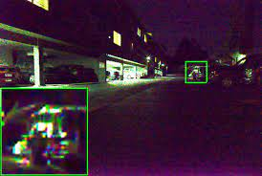
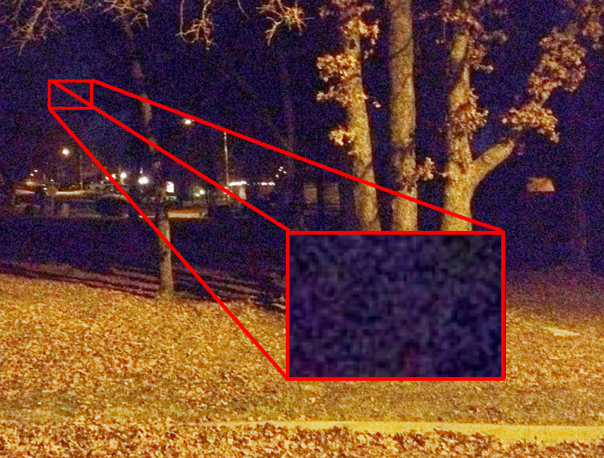
What is a noisy image?
Image noise is random variation of brightness or colour information in images, and is usually an aspect of electronic noise.

Slide 3
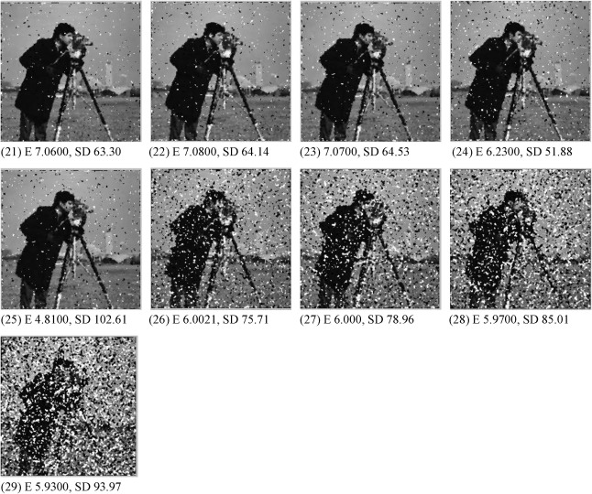
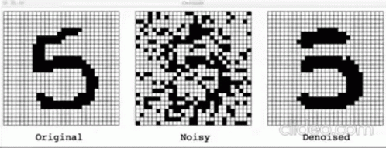
Why Denoising of an Image is important?

Slide 4
WHAT DOES FOURIER TRANSFORM DO?

Slide 5
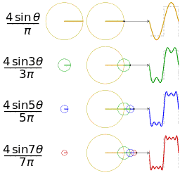
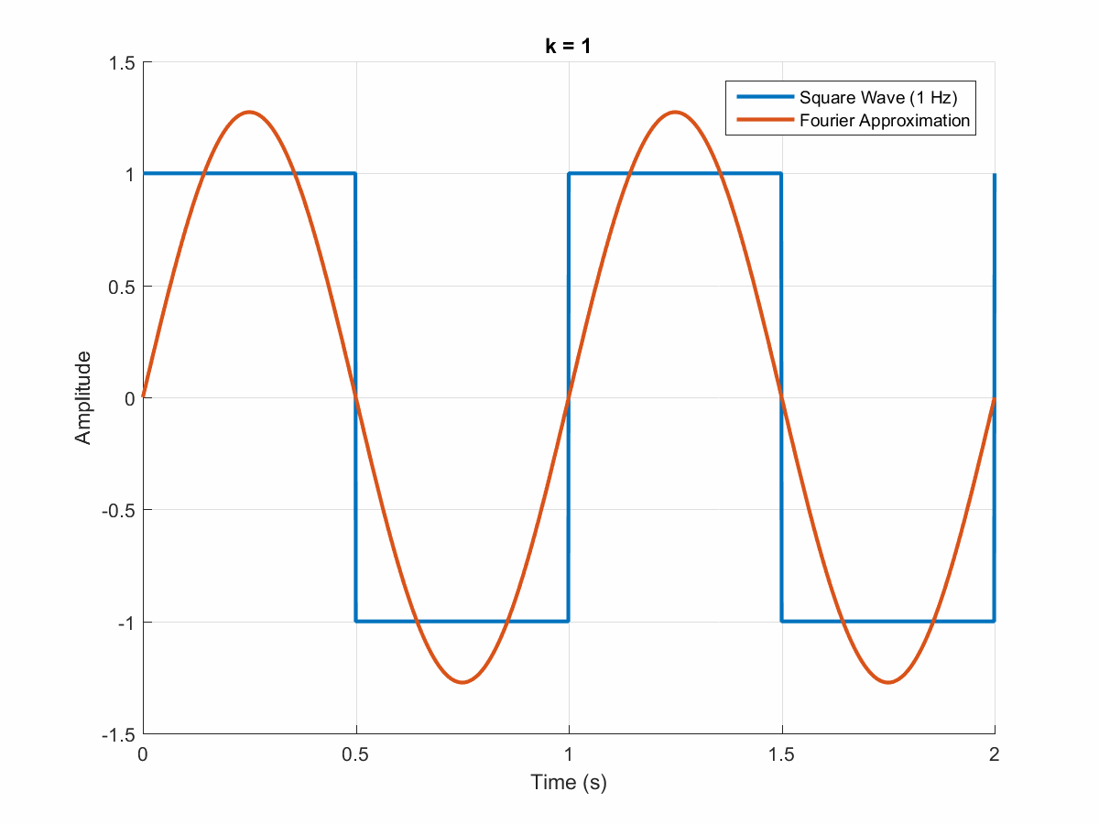
FOURIER SERIES
Figure 1: It shows how the waveform changes with the increasing value of ‘n’
Figure 2: It shows how the Fourier approximation gets closer to the Original signal with the increasing value of ‘n’ (here k=n)

Slide 6
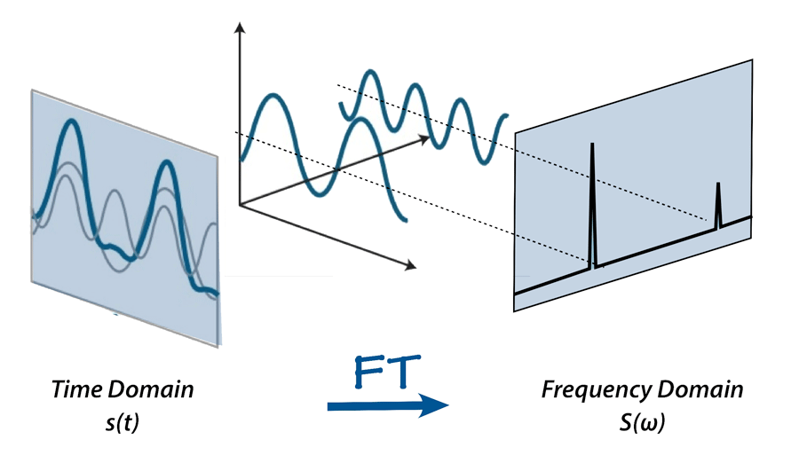
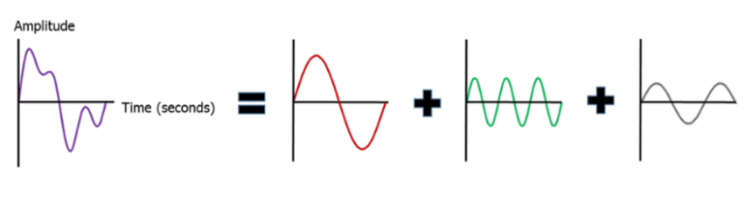
FOURIER TRANSFORM

Slide 7
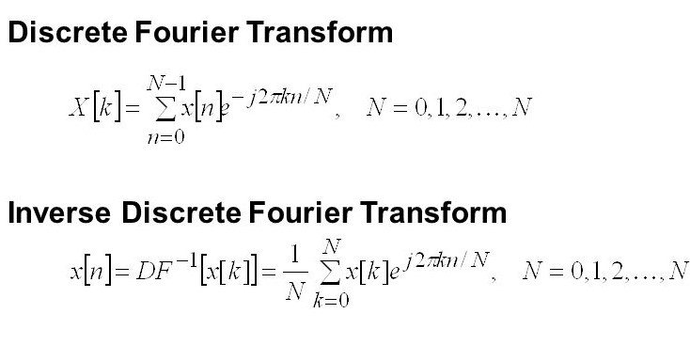

Slide 8
How Fourier Transform can be used to remove Noise from images?
Fourier Transform converts the image(time domain function) to a frequency domain function.
The higher frequency points that cause the noise once identified are replaced with lower frequencies to reduce noise.
Once the noise is removed, Inverse Fourier Transform is applied to get back the image.

Slide 9
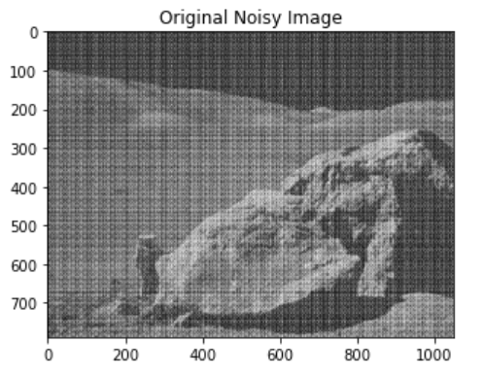
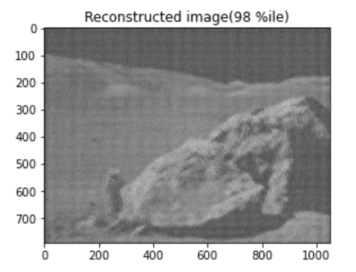
INPUT IMAGE
OUTPUT IMAGE

Slide 10
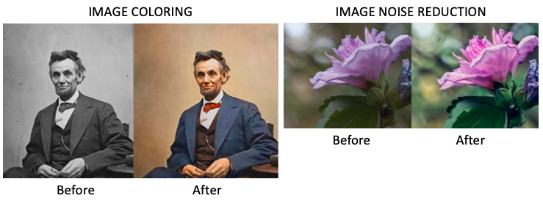
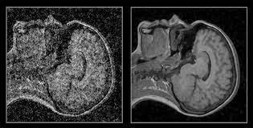
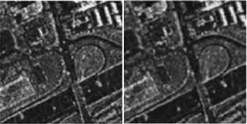
APPLICATIONS
Mixed noise reduction for hyperspectral images
Despeckling for synthetic aperture radars
Destriping for optical imagery
Image inpainting
Drone-borne sensor restoration and image denoising

Slide 11
CONCLUSION

Slide 12


